Slide 1
HPC Software in 2014
September 2014
Addison Snell, CEO
addison@intersect360.com

Slide 2
Technical vs. Enterprise Computing
Technical Computing
Enterprise Computing
Top-line missions:
  Find the oil
  Design the minivan
  Cure the disease
Driven by price/performance
Fast adoption of new technologies, algorithms, and approaches
Keeps business running
  Communicate/collaborate
  Market and sell the product
  Accounting, HR, finance, …
Driven by RAS: reliability, availability, serviceability
Slow adoption of new technologies, algorithms, and approaches

Slide 3
Where We Find HPC
High Performance Technical Computing (HPTC)
Applications in science and engineering
Top markets: academia, government labs, defense, manufacturing, bio/life science, oil/gas exploration
High Performance Business Computing (HPBC)
Applications include trading, pricing, risk management, logistics, fraud detection, online games, analytics, …
Top markets: financial services, ultrascale internet, online games, retail, entertainment

Slide 4
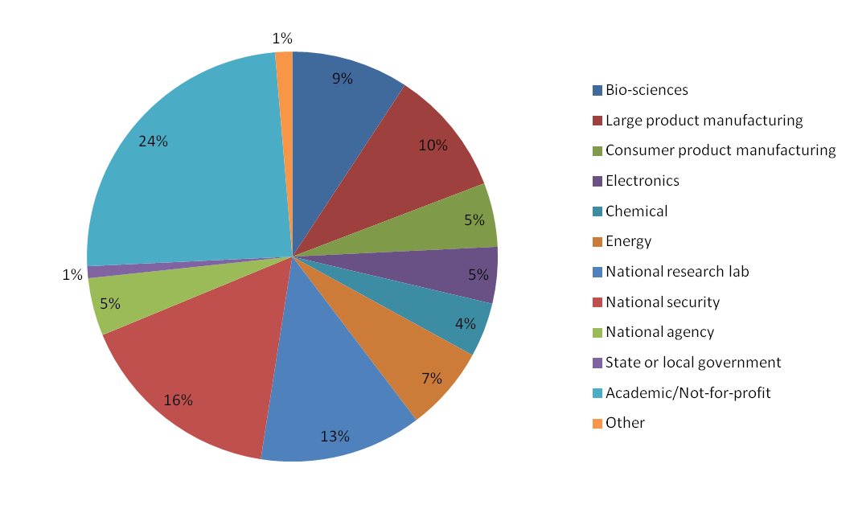
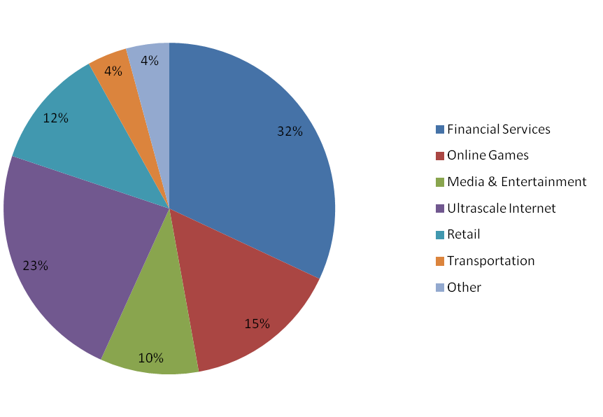
HPTC and HPBC Vertical Markets
HPTC Total Market (2012 rev., 70%) by Vertical
HPBC Total Market (2012 rev., 30%) by Vertical
24% Acad.
41% Comm.
35% Govt.
Financial services and manufacturing (auto/aero plus consumer) are about equal
Worldwide, private sector is growing faster than public sector
2013 data available to clients

Slide 5
Major HPC Software Studies in 2014
Annual HPC User Site Census: Installation data including middleware and application software
Annual HPC User Budget Map: Budget data showing percent of spending by category
Special Study: “The Big Data Opportunity for HPC,” surveyed both HPC and non-HPC enterprises on Big Data applications and infrastructures
Council on Competitiveness: “Solve. The Exascale Effect: the Benefits of Supercomputing Investment for U.S. Industry” (pending release)

Slide 6
Key Insights
HPC usage in commercial markets is growing, with expanding application categories
  Commercial growing faster than public sector
  Big Data provides a breakout opportunity for HPC
Open-source is on the rise
  Driven by pricing models and new categories
  Includes increase in business computing
Software is the most critical limiting factor in scalability
  New models of parallelism (multi-core, many-core)
  Middleware, developer tools are important investments

Slide 7
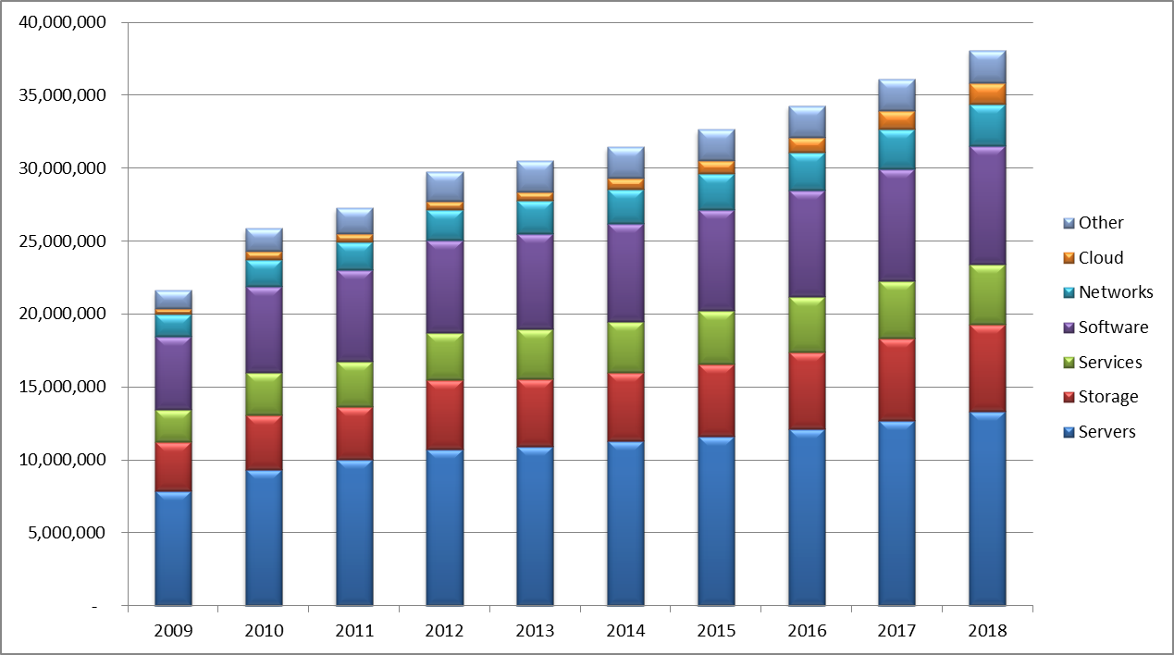
Total HPC Market Revenue ($K)
Cloud small ($613M in 2013),
but fast-growing (18.6% CAGR)
$38.1B in 2018
$30.5B in 2013
4.6% CAGR
Servers largest segment ($10.9B in 2013), followed by software ($6.5B)

Slide 8
2013 Market Performance
2013 was fourth consecutive year of growth for the market but shows a marked decline in growth rate. By segment:
  Government : Down 2.4%
  Academia: Up 2.9%
  Commercial: Up 4.6%
  HPBC: Up 4.5%
  HPTC: Up 1.6%
Note on Storage: 2013 is the first “normal” year after the flooding in Southeast Asia in the second half of 2011, which caused a significant amount of revenue to be deferred from 2011 and recognized in 2012. Therefore, 2011 storage revenue was artificially low, and 2012 was artificially high. Storage revenue has seen 7.4% CAGR since 2010.

Slide 9
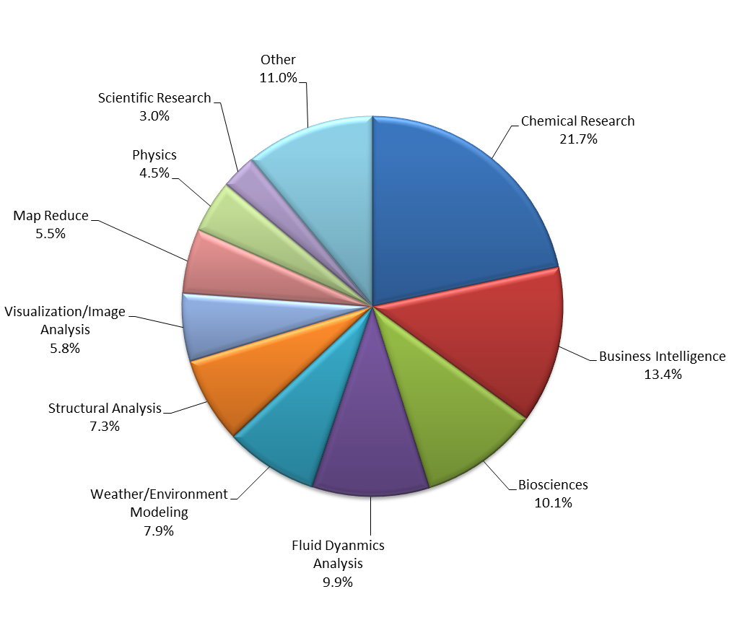
Top Overall Application Categories
Surveys conducted in the last three years
1,108 primary applications were reported by 435 HPC sites
Three-fourths of the mentions were HPTC applications and one-fourth were HPBC applications
About 80% of the 496 unique application packages had only one mention
Figure 1. Top 10 Primary Application Categories, Total Sites
N = 1,076 mentions

Slide 10
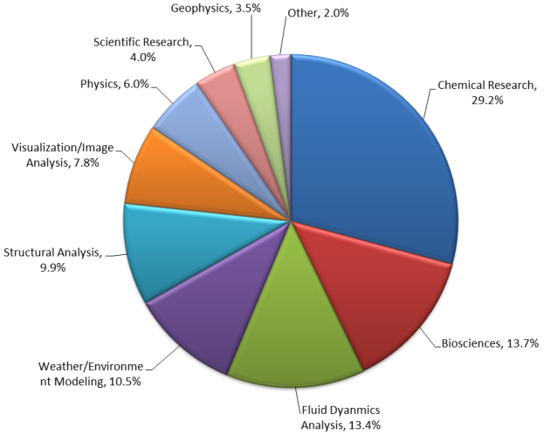
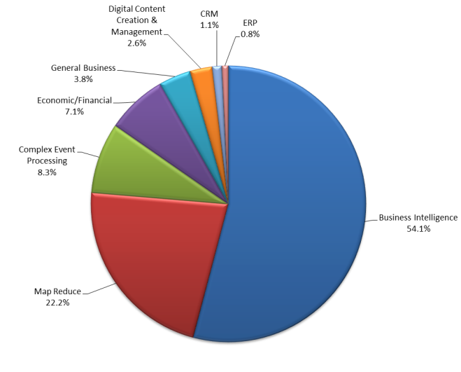
HPC Site Census: Applications

Slide 11
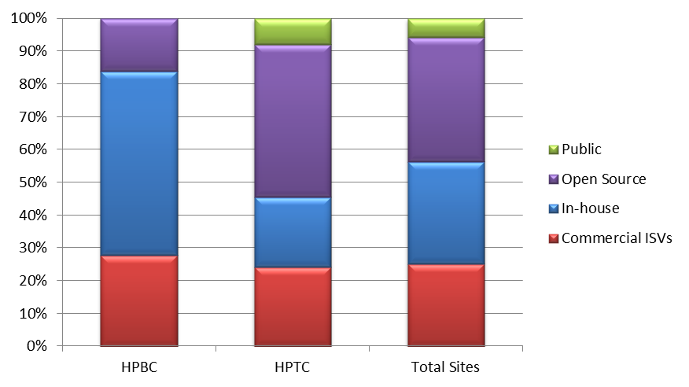
HPC Site Census: Applications
Figure 3. Supplier Type for Primary Applications, Total Sites
N=1,107 Mentions

Slide 12
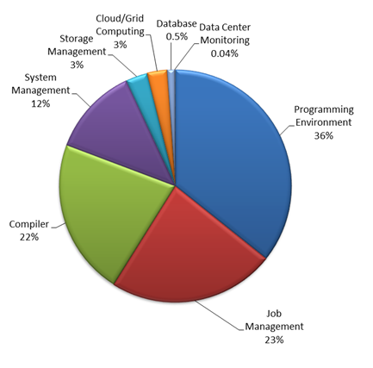
Types of Primary Middleware Reported
>300 unique packages reported
over half (62%) only mentioned once
Includes mathematical packages, e.g. Mathworks
Academic bias, but strong across all segments
Everyone needs a compiler
N = 1,252 mentions

Slide 13
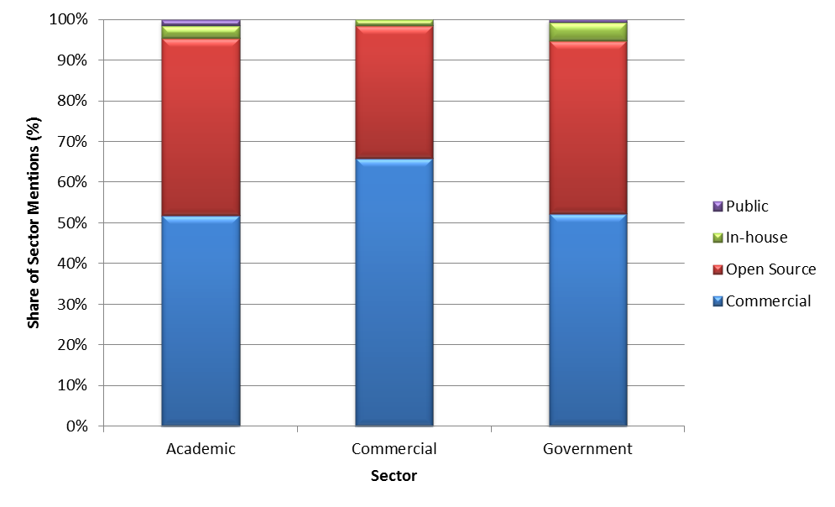
HPC Middleware by Sector
  Very little middleware is developed in-house
  Middleware is still a focus of academic research and therefore, open-source middleware is very prevalent
  Middleware has a much broader target market than application software. Middleware functionality, efficiency, and reliability impact every user of the computer system while an application impacts a subset of users, and sometimes only one user.

Slide 14
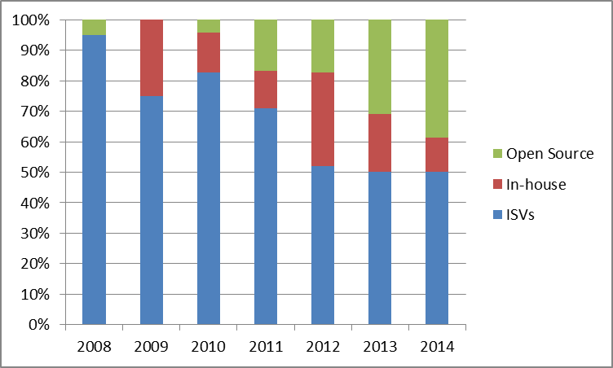
Changes in the CFD Landscape
CFD Software by Source by Survey Year

Slide 15
Big Data: Much More than Hadoop
Big Data is predominantly in-house applications
Notable change from prior year: Non-HPC sites adopting more open-source

Slide 16
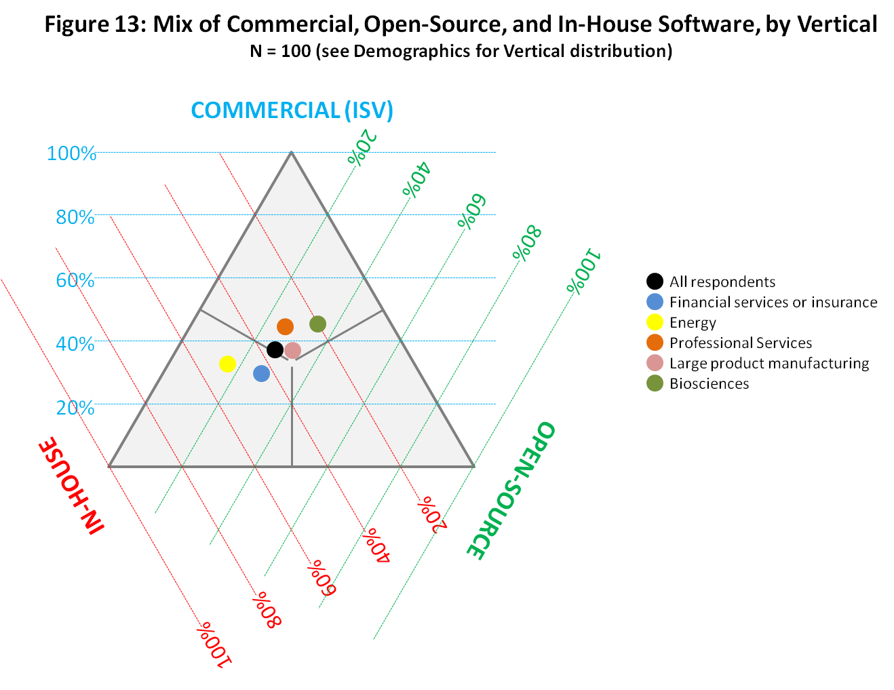
Software in Commercial HPC
Source: “Solve. The Exascale Effect: Benefits of Supercomputing Investment for U.S. Industry,” new report pending publication, with U.S. Council on Competitiveness

Slide 17
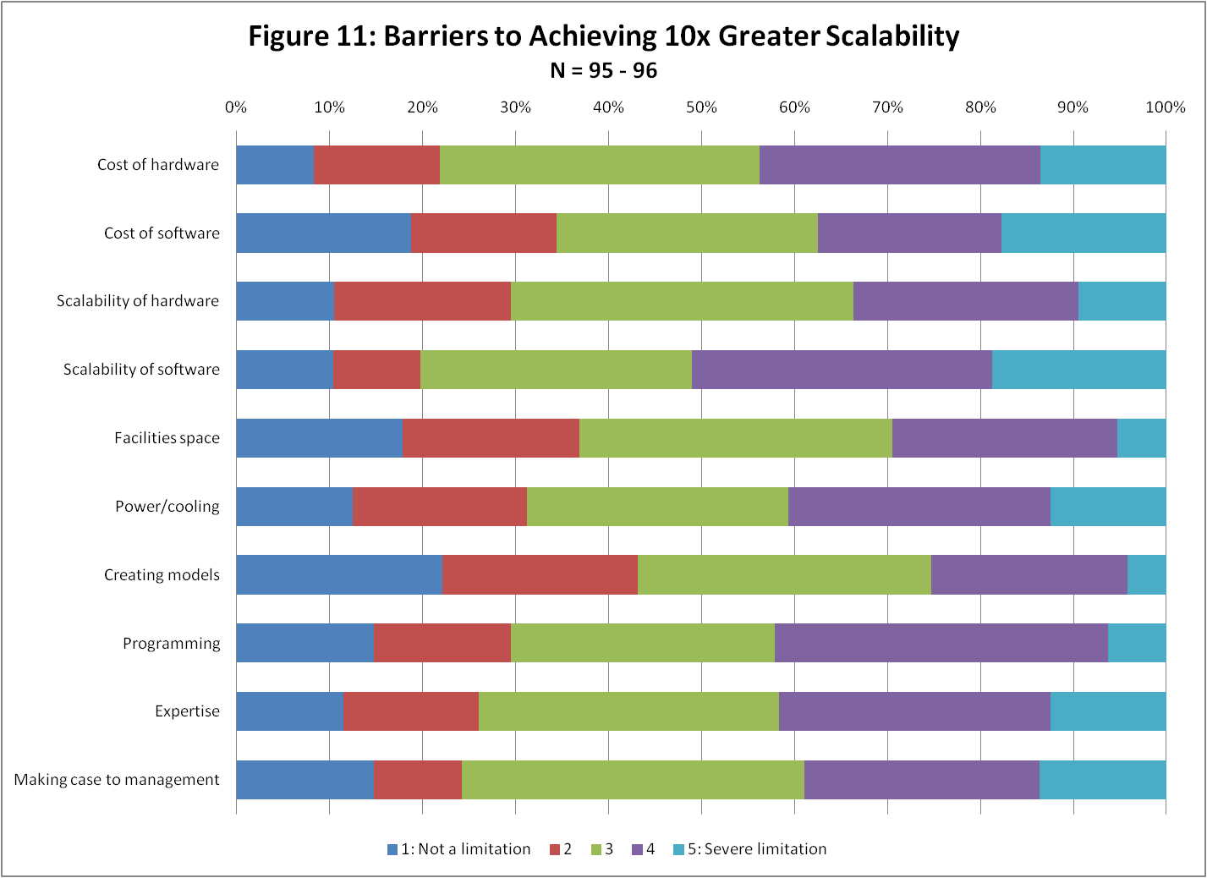
Barriers to Scalability
Source: “Solve. The Exascale Effect: Benefits of Supercomputing Investment for U.S. Industry,” new report pending publication, with U.S. Council on Competitiveness

Slide 18
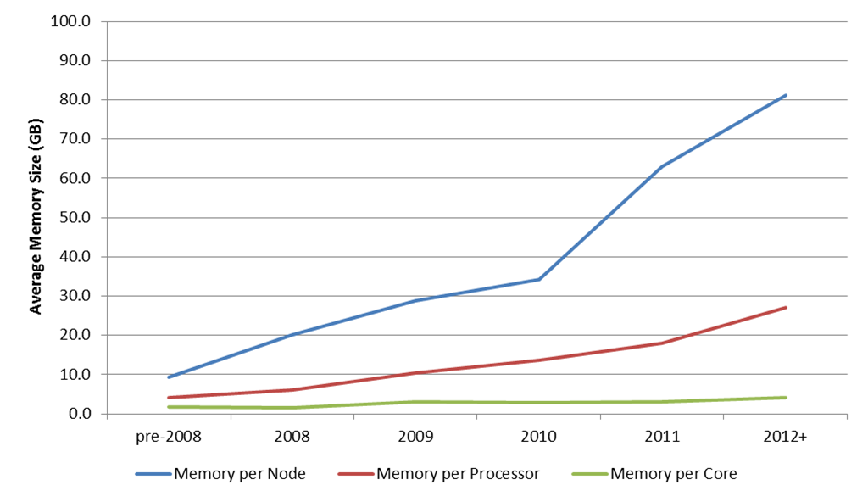
Effects of Multi-Core

Slide 19
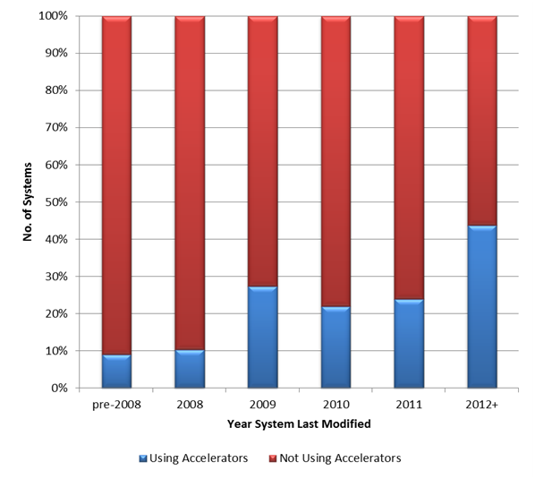
Effects of Many-Core
Accelerator penetration has almost doubled from previous year
Average number of accelerators configured per system has nearly tripled – 60 to 175

Slide 20
Effects on Skills Required
Skill sets need to evolve
  What does it mean to be a programmer?
  What does it mean to be a sys admin?
Industry finds a shortage of skilled talent
Those who know both HPC and science / engineering are “highly valued individuals”

Slide 21
Working with Intersect360 Research
If you are an HPC vendor:
  We’d love to have you as a client
  Advisory/consulting, data and insights, plus whitepapers, webinars, podcasts, etc.
  Brief us any time
If you are an HPC user:
  Free access to research if you participate
  See www.hpc500.com to join user group
  Custom work for users also available
Sign up for updates at www.intersect360.com

Slide 22

Questions
Actionable Market Intelligence for High Performance Computing

